Slide 1
Rue the ROOs: Rules of Origin and the Gains (or Losses) from Trade Agreements
Alan V. Deardorff
University of Michigan
For presentation at
REITI Workshop on Trade Costs, Tokyo, Japan
August 4, 2016

Slide 2
The Issue
Can the proliferation of FTAs be harmful?
Standard trade diversion suggests that
Individual FTAs could lower world welfare,
But if FTAs became ubiquitous, that would not happen.
If every country were to have an FTA with every other country, then there would be no trade diversion.
Examples:
US-Singapore 2004
Singapore-Korea 2006
US-Peru 2009
Singapore-Peru 2009
Korea-Peru 2011
US-Korea 2011

Slide 3
S. Korea
U.S.
2012
2004
2009
2006
2011
2009
Singapore
Peru

Slide 4
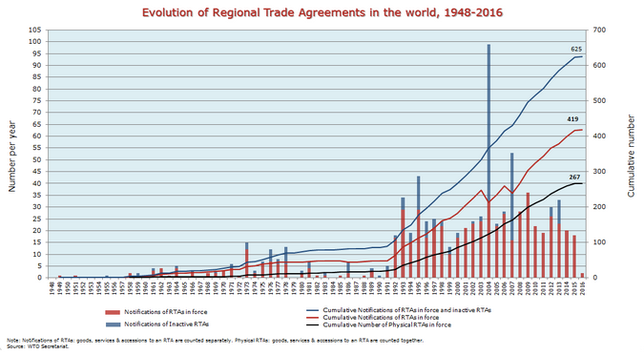
WTO
Notes:
https://www.wto.org/english/tratop_e/region_e/regfac_e.htm

Slide 15
The Issue
But that is accurate only for final goods
I will argue, via simple theoretical examples, that the presence of binding rules of origin (ROOs), in a world of traded intermediate inputs…
Will reduce world welfare below that of global free trade, even if every country has an FTA with every other country.
May even reduce every country’s welfare below what it would have achieved with no FTAs at all and positive tariffs.
That is: All FTAs can be worse than No FTAs!

Slide 16
Rules of Origin
Why an FTA must have ROOs
Countries’ external tariffs differ
Without ROOs, goods will enter through the lowest-tariff country (“trade deflection”)
If internal transport cost is less than tariff differential
ROOs specify
Requirements for goods to be considered as “originating” either in a country or in an FTA
Only trade satisfying the ROO gets a zero tariff

Slide 17
Rules of Origin
Types of ROOs
Substantial transformation
Change of “tariff heading”
The fewer the digits, the more restrictive.
Regional value added
Minimum % from inside
Maximum % from outside
Technical rules
E.g., “yarn forward” for textiles in NAFTA

Slide 18
Rules of Origin
Originating where? The issue of “cumulation”
Bilateral cumulation: Inputs only within the FTA count, regardless of other existing FTAs
Diagonal cumulation: Inputs from selected other countries count (such as other FTA partners)
In practice, many FTAs (and all involving the U.S.) use bilateral cumulation
(Most restrictive)

Slide 19
Why ROOs matter
Some trade does not qualify, so tariffs remain in effect.
Worse: Some producers will alter their choice of inputs in order to satisfy ROOs. This raises costs
Examples will illustrate both

Slide 20
Example 2. (General equilibrium)
3 countries, each with same amount of labor
3 industries (but 6 goods)
Goods demanded in fixed proportions (X=Y=Z)
Each industry has separate input & output
Constant labor requirements (a la Ricardo)
Country A |  |  |  |  | Country B |  |  |  |  | Country C
 | In | Out | Tot |  |  | In | Out | Tot |  |  | In | Out | Tot
X | 1 | 2 |  |  | X | 3 | 1 |  |  | X | 2 | 3
Y | 2 | 3 |  |  | Y | 1 | 2 |  |  | Y | 3 | 1
Z | 3 | 1 |  |  | Z | 2 | 3 |  |  | Z | 1 | 2

Slide 21
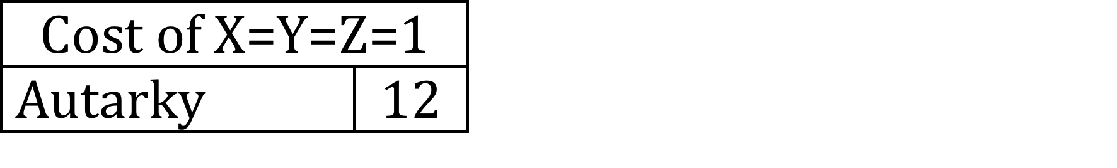
Example 2. (General equilibrium)
3 countries, each with same amount of labor
3 industries (but 6 goods)
Goods demanded in fixed proportions (X=Y=Z)
Each industry has separate input & output
Constant labor requirements (a la Ricardo)
Country A |  |  |  |  | Country B |  |  |  |  | Country C
 | In | Out | Tot |  |  | In | Out | Tot |  |  | In | Out | Tot
X | 1 | 2 |  |  | X | 3 | 1 |  |  | X | 2 | 3
Y | 2 | 3 |  |  | Y | 1 | 2 |  |  | Y | 3 | 1
Z | 3 | 1 |  |  | Z | 2 | 3 |  |  | Z | 1 | 2

Slide 22
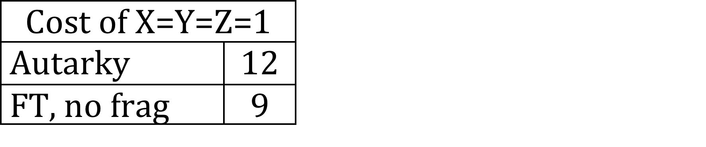
Example 2
Country A |  |  |  |  | Country B |  |  |  |  | Country C
 | In | Out | Tot |  |  | In | Out | Tot |  |  | In | Out | Tot
X | 1 | 2 | 3 |  | X | 3 | 1 | 4 |  | X | 2 | 3 | 5
Y | 2 | 3 | 5 |  | Y | 1 | 2 | 3 |  | Y | 3 | 1 | 4
Z | 3 | 1 | 4 |  | Z | 2 | 3 | 5 |  | Z | 1 | 2 | 3
Comparative advantage if “fragmentation” not possible
input and output must be produced together,

Slide 23
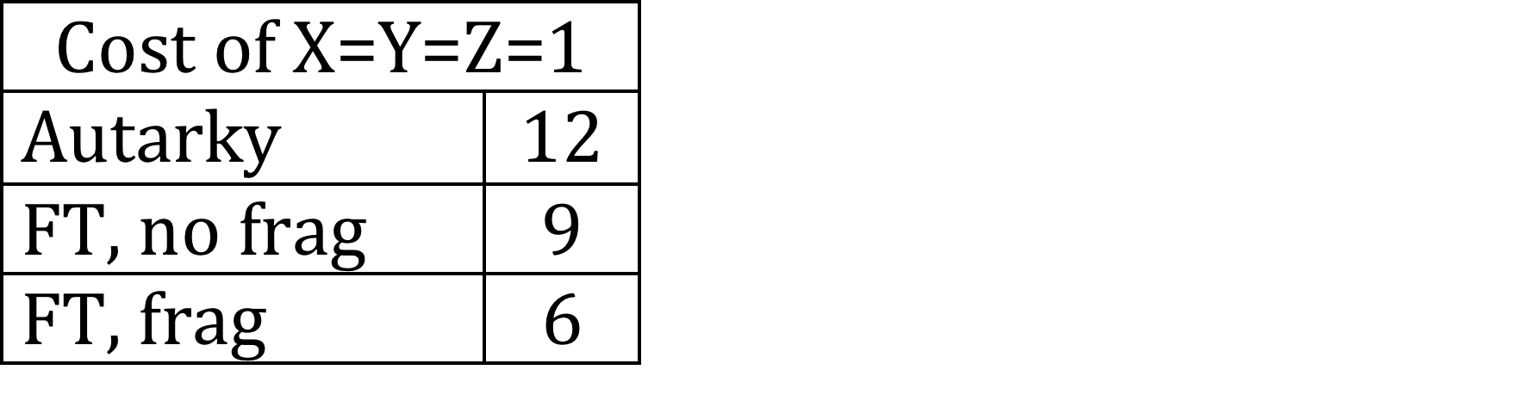
Example 2
Country A |  |  |  |  | Country B |  |  |  |  | Country C
 | In | Out | Tot |  |  | In | Out | Tot |  |  | In | Out | Tot
X | 1 | 2 | 3 |  | X | 3 | 1 | 4 |  | X | 2 | 3 | 5
Y | 2 | 3 | 5 |  | Y | 1 | 2 | 3 |  | Y | 3 | 1 | 4
Z | 3 | 1 | 4 |  | Z | 2 | 3 | 5 |  | Z | 1 | 2 | 3
Comparative advantage if fragmentation is possible and there is multilateral free trade

Slide 24
Example 2
Trade Flows: Inputs
Country A |  |  |  |  | Country B |  |  |  |  | Country C
 | In | Out | Tot |  |  | In | Out | Tot |  |  | In | Out | Tot
X | 1 | 2 | 3 |  | X | 3 | 1 | 4 |  | X | 2 | 3 | 5
Y | 2 | 3 | 5 |  | Y | 1 | 2 | 3 |  | Y | 3 | 1 | 4
Z | 3 | 1 | 4 |  | Z | 2 | 3 | 5 |  | Z | 1 | 2 | 3
Comparative advantage if fragmentation is possible and there is multilateral free trade

Slide 25
Example 2
Trade Flows: Inputs, Outputs
Country A |  |  |  |  | Country B |  |  |  |  | Country C
 | In | Out | Tot |  |  | In | Out | Tot |  |  | In | Out | Tot
X | 1 | 2 | 3 |  | X | 3 | 1 | 4 |  | X | 2 | 3 | 5
Y | 2 | 3 | 5 |  | Y | 1 | 2 | 3 |  | Y | 3 | 1 | 4
Z | 3 | 1 | 4 |  | Z | 2 | 3 | 5 |  | Z | 1 | 2 | 3
Comparative advantage if fragmentation is possible and there is multilateral free trade

Slide 26
Example 2
Trade Flows: Inputs, Outputs
Country A |  |  |  |  | Country B |  |  |  |  | Country C
 | In | Out | Tot |  |  | In | Out | Tot |  |  | In | Out | Tot
X | 1 | 2 | 3 |  | X | 3 | 1 | 4 |  | X | 2 | 3 | 5
Y | 2 | 3 | 5 |  | Y | 1 | 2 | 3 |  | Y | 3 | 1 | 4
Z | 3 | 1 | 4 |  | Z | 2 | 3 | 5 |  | Z | 1 | 2 | 3
But note that some of these exports (in red) use inputs from a third country.
They may not satisfy ROOs, once FTAs exist

Slide 27
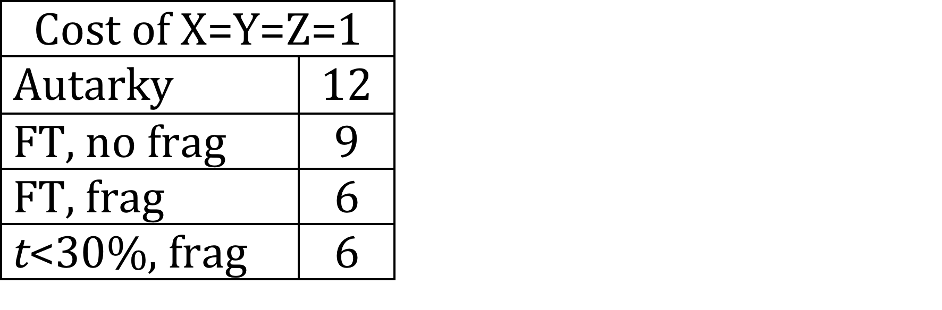
Example 2
Trade Flows: Inputs, Outputs
Country A |  |  |  |  | Country B |  |  |  |  | Country C
 | In | Out | Tot |  |  | In | Out | Tot |  |  | In | Out | Tot
X | 1 | 2 | 3 |  | X | 3 | 1 | 4 |  | X | 2 | 3 | 5
Y | 2 | 3 | 5 |  | Y | 1 | 2 | 3 |  | Y | 3 | 1 | 4
Z | 3 | 1 | 4 |  | Z | 2 | 3 | 5 |  | Z | 1 | 2 | 3
Note: Even with ad valorem tariff, t, on all trade,
if t < ~30%, result is same as with Free Trade (FT),
since t is less than cost advantage
E.g., B’s price of X to A: 1.3(1+1.3(1)) = 2.99 < 3

Slide 28
Example 2
Trade Flows:
Country A |  |  |  |  | Country B |  |  |  |  | Country C
 | In | Out | Tot |  |  | In | Out | Tot |  |  | In | Out | Tot
X | 1 | 2 | 3 |  | X | 3 | 1 | 4 |  | X | 2 | 3 | 5
Y | 2 | 3 | 5 |  | Y | 1 | 2 | 3 |  | Y | 3 | 1 | 4
Z | 3 | 1 | 4 |  | Z | 2 | 3 | 5 |  | Z | 1 | 2 | 3
Now suppose:
3 bilateral FTAs
ROOs inhibit output-trades shown by red arrows
How? Depends on tariffs & ROOs. Assume:
ROO content requirement > 50% and t > 50%
ROO > 50% since In_{A}/P_{X}(In_{A}) = 50%
t > 50% raises P_{X}(In_{A}) > 3 = P_{X}(In_{C})

Slide 29
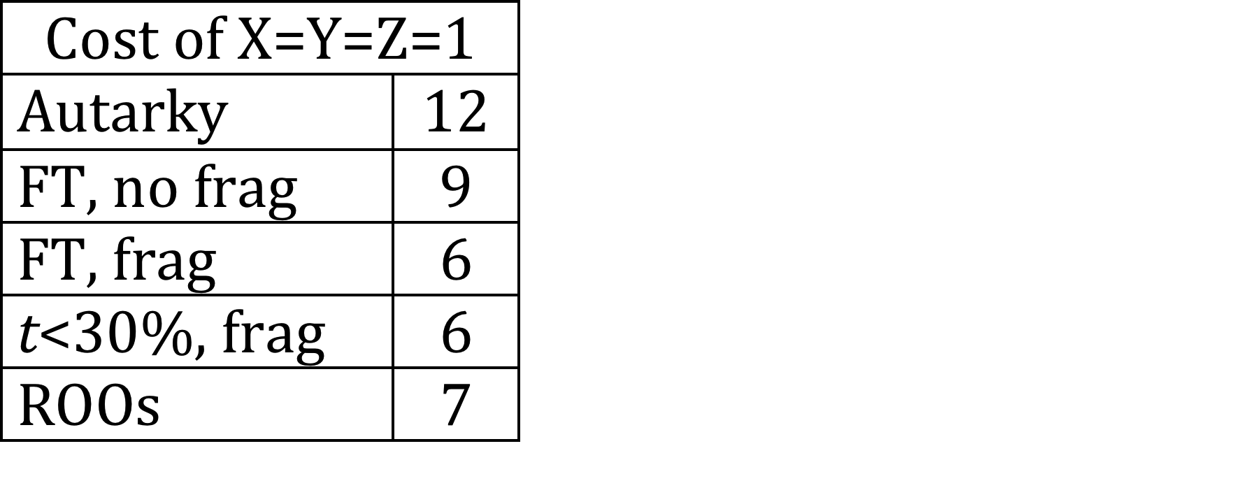
Example 2
Trade Flows: Inputs, Outputs
Country A |  |  |  |  | Country B |  |  |  |  | Country C
 | In | Out | Tot |  |  | In | Out | Tot |  |  | In | Out | Tot
X | 1 | 2 | 3 |  | X | 3 | 1 | 4 |  | X | 2 | 3 | 5
Y | 2 | 3 | 5 |  | Y | 1 | 2 | 3 |  | Y | 3 | 1 | 4
Z | 3 | 1 | 4 |  | Z | 2 | 3 | 5 |  | Z | 1 | 2 | 3
Those trades will instead be sourced within FTAs
Cost rises by 1 unit; world loses.
Cost for 1-unit bundle of X, Y, & Z rises 6➔7
Loss of GDP due to FTAs, compared to free trade: 1/6

Slide 30
Implication (not surprising)
ROOs can reduce the gains from ubiquitous FTAs below global free trade.

Slide 31
Implication?
Question: Can ROOs actually cause the net welfare effect of FTAs to be negative (compared to positive tariffs and no FTAs)?
In this example, No.
Needed t < 30% to get free-trade welfare
Needed t > 50% to induce higher-cost sourcing
But with different numbers, Yes.

Slide 32
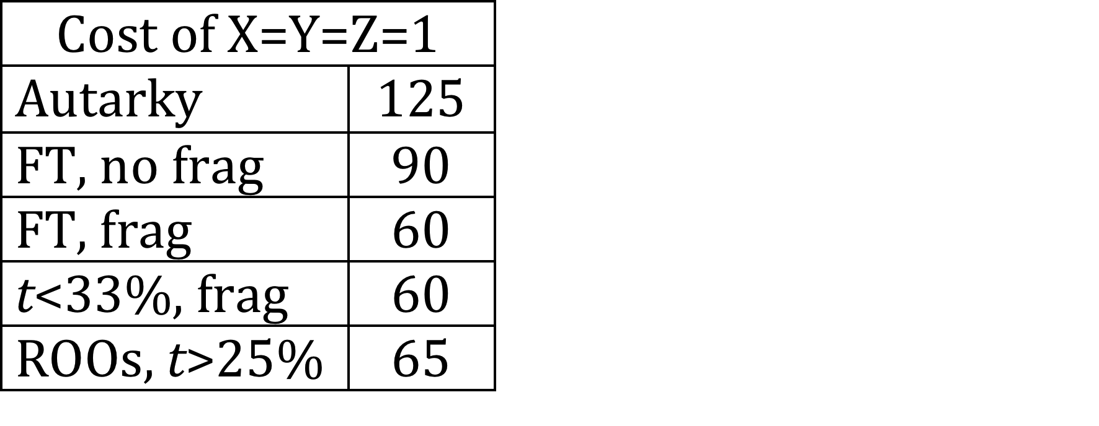
Example 2
Example 3.
Country A |  |  |  |  | Country B |  |  |  |  | Country C
 | In | Out | Tot |  |  | In | Out | Tot |  |  | In | Out | Tot
X | 10 | 30 | 40 |  | X | 20 | 10 | 30 |  | X | 15 | 40 | 55
Y | 15 | 40 | 55 |  | Y | 10 | 30 | 40 |  | Y | 20 | 10 | 30
Z | 20 | 10 | 30 |  | Z | 15 | 40 | 55 |  | Z | 10 | 30 | 40
Numbers here are a different, but patterns of trade are the same.
Tariff between 25% and 33% yields result
E.g., t=30%

Slide 33
Example 2
Example 3.
Country A |  |  |  |  | Country B |  |  |  |  | Country C
 | In | Out | Tot |  |  | In | Out | Tot |  |  | In | Out | Tot
X | 10 | 30 | 40 |  | X | 20 | 10 | 30 |  | X | 15 | 40 | 55
Y | 15 | 40 | 55 |  | Y | 10 | 30 | 40 |  | Y | 20 | 10 | 30
Z | 20 | 10 | 30 |  | Z | 15 | 40 | 55 |  | Z | 10 | 30 | 40
Check that t=30% works:
(Check for X only; Y and Z are symmetric)
Without FTAs
B buys X_{IN} for 1.3(10) = 13
B’s cost of X = 13+10 = 23
A&C buy X from B for 1.3(23) = 29.9 < 40, 55
(A’s, C’s cost from self)
With FTAs
If B buys X_{IN} from A for 10
B’s cost of X = 10+10 = 20
If C buys X from B, it pays 1.3(20) = 26 > 25
(B’s cost with X_{IN} from C)

Slide 34
Example 2
Example 3.
Country A |  |  |  |  | Country B |  |  |  |  | Country C
 | In | Out | Tot |  |  | In | Out | Tot |  |  | In | Out | Tot
X | 10 | 30 | 40 |  | X | 20 | 10 | 30 |  | X | 15 | 40 | 55
Y | 15 | 40 | 55 |  | Y | 10 | 30 | 40 |  | Y | 20 | 10 | 30
Z | 20 | 10 | 30 |  | Z | 15 | 40 | 55 |  | Z | 10 | 30 | 40
X_{IN} from A
Result of Example 3:
With tariffs on all trade of 30%, consumption bundle requires 5/60 = ~8% more labor with FTAs than without.

Slide 35
Implication (surprising?)
ROOs actually can cause the net welfare effect of ubiquitous FTAs to be negative for all countries, compared to no FTAs and positive tariffs.

Slide 36
Are ROOs better than this, or worse?
Better?
My examples all assumed that producers moved all inputs into the FTA.
If they only move just enough to satisfy a ROO, then harm will be less.

Slide 37
Are ROOs better than this, or worse?
Worse? I had
Only two stages of production: input and output
Only three goods and countries
Examples in the paper show that cost rises with
more stages of production, and
more than three goods and countries

Slide 38
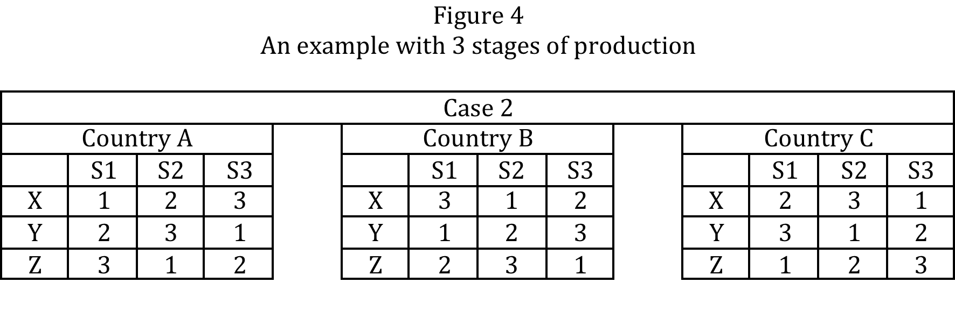
Cost rises from 9 to 11 (22%)

Slide 39
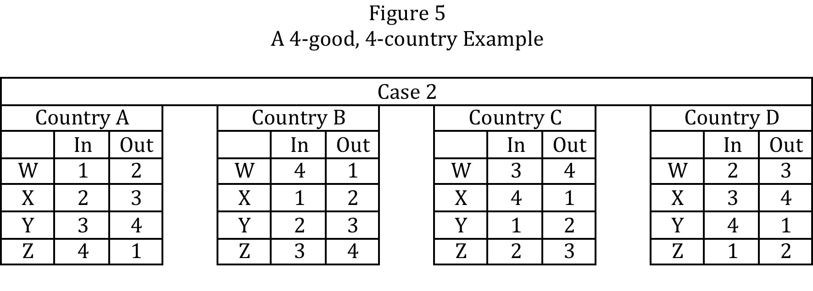
Cost rises from 8 to 11 (38%)

Slide 40
What to Do?
First best: Multilateral free trade (of course)
Second best: greater cumulation
Specify ROOs so that inputs originating in any FTA partner qualify under other FTAs
Third best: Permit within-FTA tariffs only on portion not originating, not on full value

Slide 41
What to Do?
Is there hope?
EU seems to use more cumulation than the US
The negotiated Transpacific Partnership (TPP) does include such cumulation (to my relief, as US didn’t want that)
That’s good, but note that TPP still doesn’t have diagonal cumulation to countries outside TPP with bilateral FTAs

Slide 42
Conclusion
The world could,
but hopefully won’t,
Choke on spaghetti;
Or at least get indigestion.

